Slide 1
PRNG
This lecture is mainly based on the power point slides by Professor Lawrie Brown.
Notes:
Zili Shao

Slide 2
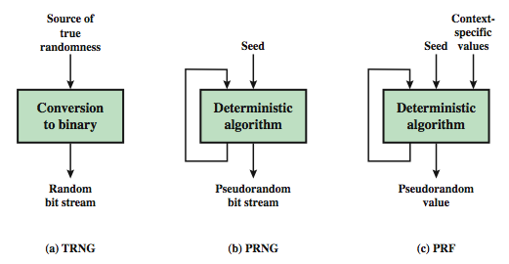
Random Number Generator
TRNG: Source of true randomness: key strokes, hard disk electrical activities, mouse movements, and instantaneous values of the system clock.
PRNG: Produce an open-ended sequence of bits, the key stream for the stream cipher.
PRF: produce a string of bits of some fixed length, for example, a symmetric encryption keys, or nonces. The context specific values, usually, are a user id, or an application ID.
Notes:
TRNG: Source of true randomness: Entropy source.
Zili Shao

Slide 3
PRNG Requirements
randomness
  uniformity, scalability, consistency
unpredictability
  forward & backward unpredictability
  use same tests to check
characteristics of the seed
  secure
  if known adversary can determine output
  so must be random or pseudorandom number
Notes:
When a PRNG or PRF is used for a cryptographic application, then the basic requirement is that an adversary who does not know the seed is unable to determine the pseudorandom string. This general requirement for secrecy of the output of a PRNG or PRF leads to specific requirements in the areas of randomness, unpredictability, and the characteristics of the seed.
In terms of randomness, the requirement for a PRNG is that the generated bit stream appear random even though it is deterministic. NIST SP 800-22 (A Statistical Test Suite for Random and Pseudorandom Number Generators for Cryptographic Applications) specifies that the tests should seek to establish the following three characteristics: uniformity, scalability, consistency. SP 800-22 lists 15 separate tests of randomness.
A stream of pseudorandom numbers should exhibit two forms of unpredictability: forward unpredictability, backward unpredictability. The same set of tests for randomness also provide a test of unpredictability. If the generated bit stream appears random, then it is not possible to predict some bit or bit sequence from knowledge of any previous bits. Similarly, if the bit sequence appears random, then there is no feasible way to deduce the seed based on the bit sequence. That is, a random sequence will have no correlation with a fixed value (the seed).
For cryptographic applications, the seed that serves as input to the PRNG must be secure. Because the PRNG is a deterministic algorithm, if the adversary can deduce the seed, then the output can also be determined. Therefore, the seed must be unpredictable. In fact, the seed itself must be a random or pseudorandom number.

Slide 4
PRNG Requirements
Randomness
  Uniformity – at any point in the generation of the PRN sequence, the occurrence of a zero or a one is equally likely (i.e., p = 0.5)
  Scalability – any test for randomness applicable to a sequence can also be applied to any random subsequence (it should pass)
  Consistency – the characteristics of the PRN sequence of the PRNG must not depend on the seed used
Notes:
When a PRNG or PRF is used for a cryptographic application, then the basic requirement is that an adversary who does not know the seed is unable to determine the pseudorandom string. This general requirement for secrecy of the output of a PRNG or PRF leads to specific requirements in the areas of randomness, unpredictability, and the characteristics of the seed.
In terms of randomness, the requirement for a PRNG is that the generated bit stream appear random even though it is deterministic. NIST SP 800-22 (A Statistical Test Suite for Random and Pseudorandom Number Generators for Cryptographic Applications) specifies that the tests should seek to establish the following three characteristics: uniformity, scalability, consistency. SP 800-22 lists 15 separate tests of randomness.
A stream of pseudorandom numbers should exhibit two forms of unpredictability: forward unpredictability, backward unpredictability. The same set of tests for randomness also provide a test of unpredictability. If the generated bit stream appears random, then it is not possible to predict some bit or bit sequence from knowledge of any previous bits. Similarly, if the bit sequence appears random, then there is no feasible way to deduce the seed based on the bit sequence. That is, a random sequence will have no correlation with a fixed value (the seed).
For cryptographic applications, the seed that serves as input to the PRNG must be secure. Because the PRNG is a deterministic algorithm, if the adversary can deduce the seed, then the output can also be determined. Therefore, the seed must be unpredictable. In fact, the seed itself must be a random or pseudorandom number.

Slide 5
Linear Congruential
Generator
common iterative technique using:
  Xn+1 = (aXn + c) mod m
given suitable values of parameters can produce a long random-like sequence
suitable criteria to have are:
  function generates a full-period
  generated sequence should appear random
  efficient implementation with 32-bit arithmetic
note that an attacker can reconstruct sequence given a small number of values
have possibilities for making this harder
Notes:
By far the most widely used technique for pseudorandom number generation is the “Linear Congruential Generator”, first proposed by Lehmer. It uses successive values from an iterative equation. Given suitable values of parameters can produce a long random-like sequence, but there are only a small number of such good choices. Note that the sequence, whilst looking random, is highly predictable, and an attacker can reconstruct the sequence knowing only a small number of values. There are some approaches to making this harder to do in practice by modifying the numbers in some way, see text.

Slide 6
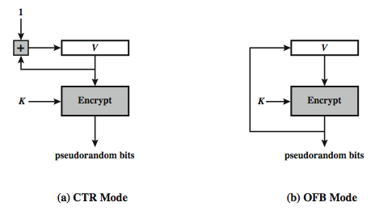
Using Block Ciphers as PRNGs
for cryptographic applications, can use a block cipher to generate random numbers (recommended in SP 800-90)
often for creating session keys from master key
CTR
  Xi = EK[Vi]
OFB
  Xi = EK[Xi-1]
Notes:
A popular approach to PRNG construction is to use a symmetric block cipher as the heart of the PRNG mechanism. For any block of plaintext, a symmetric block cipher produces an output block that is apparently random. That is, there are no patterns or regularities in the ciphertext that provide information that can be used to deduce the plaintext. Thus, a symmetric block cipher is a good candidate for building a pseudorandom number generator. If an established, standardized block cipher is used, such as DES or AES, then the security characteristics of the PRNG can be established. Further, many applications already make use of DES or AES, so the inclusion of the block cipher as part of the PRNG algorithm is straightforward. Two approaches that use a block cipher to build a PNRG have gained widespread acceptance: the CTR mode and the OFB mode. The CTR mode is recommended in SP 800-90, in the ANSI standard X9.82 (Random Number Generation), and RFC 4086. The OFB mode is recommended in X9.82 and RFC 4086. Stallings Figure 7.3 illustrates the two methods. In each case, the seed consists of two parts: the encryption key value and a value V that will be updated after each block of pseudorandom numbers is generated. In the CTR case, the value of V is incremented by 1 after each encryption. In the case of OFV, the value of V is updated to equal the value of the preceding PRNG block. In both cases, pseudorandom bits are produced on block at a time.

Slide 7
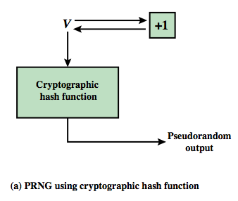
PRNG using a Hash Function
hash PRNG from SP800-90 and ISO18031
  take seed V
  repeatedly add 1
  hash V
  use n-bits of hash as random value
secure if good hash used
Notes:
Stallings Figure 12.12a shows the basic strategy for a hash-based PRNG specified in SP 800-90 and ISO 18031. The algorithm takes as input: V = seed; seedlen = bit length of V >= k + 64, where k is a desired security level expressed in bits; n = desired number of output bits. The algorithm uses the cryptographic hash function H with an hash value output of outlen bits. The basic operation of the algorithm is:
m = ceil(n/outlen)
data = V
W = the null string
for i = 1 to m
w_{i} = H(data)
W = W || w_{i}
data = (data + 1) mod 2^{seedlen}
return leftmost n bits of W
Thus, the pseudorandom bit stream is w 1 || w2 || … || wm, with the final block truncated if required. The SP 800-90 specification also provides for periodically updating V to enhance security. The specification also indicates that there are no known or suspected weaknesses in the hash- based approach for a strong cryptographic hash algorithm, such as SHA-2.

Slide 8
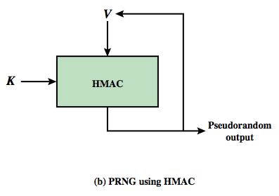
PRNG using a MAC
MAC PRNGs in SP800-90, IEEE 802.11i, TLS
  use key
  input based on last hash in various ways
Notes:
Although there are no known or suspected weaknesses in the use of a cryptographic hash function for a PRNG as shown on the previous slide, a higher degree of confidence can be achieved by using a MAC. Almost invariably, HMAC is used for constructing a MAC-based PRNG. For the MAC based approach, there are two inputs, a key K and a seed V. In effect, the combination of K and V form the overall seed for the PRNG specified in SP 800-90. Stallings Figure 12.12b shows the basic structure of the PRNG mechanism. Stallings Figure 12.13 shows the logic for 3 HMAC PRNG’s. Note that the key remains the same for each block of output, and in SP 800-90 the data input for each block is equal to the tag output of the previous block. The IEEE 802.11i form uses a counter for enhanced security. The TLS form uses two MAC uses per output block. The SP 800-90 specification also provides for periodically updating K and V to enhance security. The SP 800-90 logic is:
m = ceil(n/outlen)
w₀ = V
W = the null string
for i = 1 to m
w_{i} = MAC(K, w_{i-1})
W = W || w_{i}
data = (data + 1) mod 2^{seedlen}
return leftmost n bits of W

Slide 9


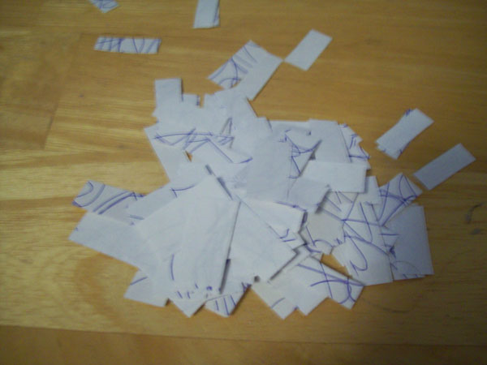
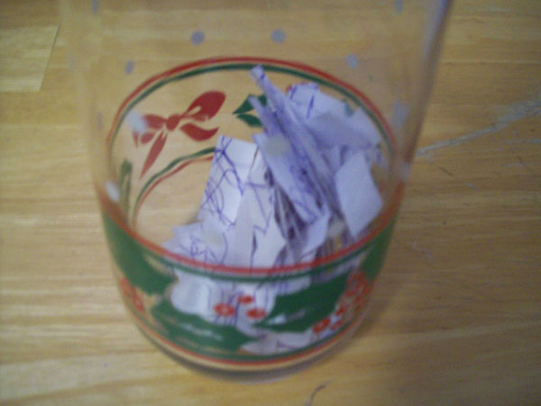
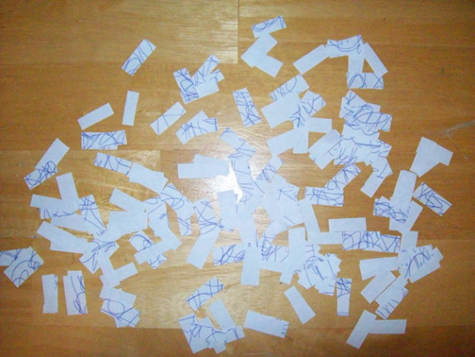

A (Possible) TRNG Example
Source: https://defuse.ca/manual-random-number-generator.htm

Slide 10
C-PRNG
Cryptographic pseudo-random number generator (CPRNG) is a pseudo-random number generator (PRNG) with properties that make it suitable for use in cryptography.
 | PRNG | C-PRNG
Java | Random random = new Random(); | SecureRandom random = new SecureRandom();
PHP | srand(); | Random_bytes()
Both of these two functions on the left use a statistical PRNG seeded with the current value of the system clock to generate a random number.
Notes:
Zili Shao

Slide 11


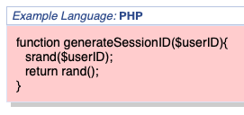
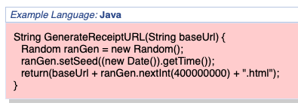
Examples
Source: https://cwe.mitre.org/data/definitions/337.html
Source: https://cwe.mitre.org/data/definitions/331.html
Notes:
Both of these examples (C and Java) use a statistical PRNG seeded with the current value of the system clock to generate a random number. An attacker can easily predict the seed used by these PRNGs, and so also predict the stream of random numbers generated. Note these examples also exhibit CWE-338 (Use of Cryptographically Weak PRNG).
CWE: Common Weakness Enumeration.
CWE-337: Predictable Seed in Pseudo-Random Number Generator (PRNG)
CVE: Common Vulnerabilities and Exposures
Zili Shao

Slide 12
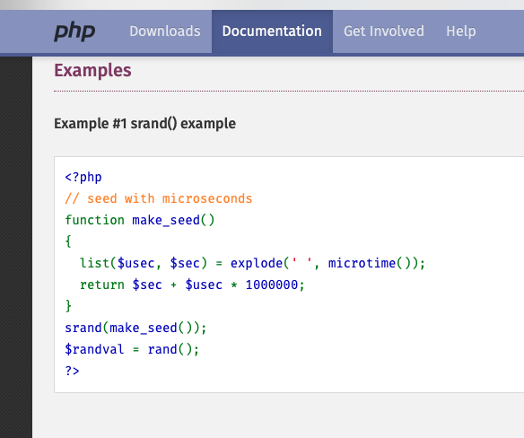
Examples

Slide 13
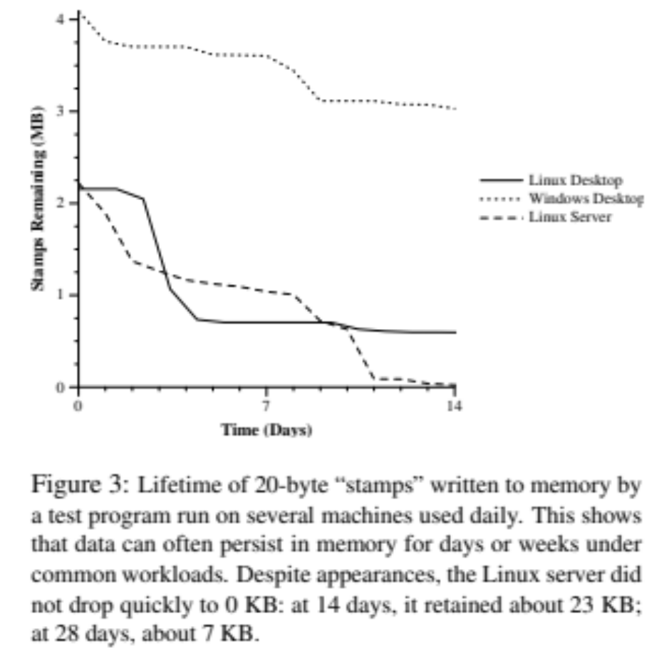
Sensitive Data in Memory
Minimizing the retention of secrets (i.e., keys) in memory.
“malloc” operation
Source: Shredding Your Garbage: Reducing Data Lifetime Through Secure Deallocation

Slide 14
Good Practices
Minimizing the retention time of sensitive information in the memory
Prevent unnecessary duplication/sharing
Erase it securely

Slide 15
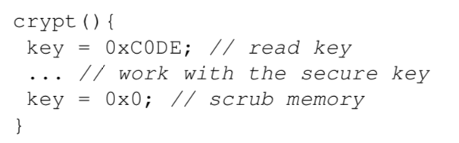
Be Careful about Your Compiler
Key = 0x0 could be discarded by the compiler

Slide 16
Do not make it permanent if unnecessary
Operating Systems
  Swap
Solutions
  Linux: mlock(), munlock()
    mlock()lock part or all of the calling process's virtual address space into RAM, preventing that memory from being paged to the swap area.
  Windows: VirtualLock(), VirtualUnlock()
    VirtualLock() locks the specified region of the process's virtual address space into physical memory, ensuring that subsequent access to the region will not incur a page fault.
Notes:
mlock() lock part or all of the calling process's virtual address space into RAM, preventing that memory from being paged to the swap area.
munlock() unlocks pages in the address. After this call, all pages that contain a part of the specified memory range can be moved to external swap space again by the kernel.
VirtualLock() locks the specified region of the process's virtual address space into physical memory, ensuring that subsequent access to the region will not incur a page fault.
VirtualUnlock() unlocks a specified range of pages in the virtual address space of a process, enabling the system to swap the pages out to the paging file if necessary.
Zili Shao

Slide 17
An Application of Hash: Password Storage
Basic Idea
  User has a secret password
  System checks password to authenticate a user
Issues
  How is the password stored?
  How does system check password?
  How hard is it to guess a password?
    Even if the password file is gotten by attackers, it is hard for attackers to guess passwords.

Slide 18


Basic Scheme – Use Hash!
Account | Hash(Password)
David | kadd0d9fdas
John | jdssoisdfxdfe
…… | ……
Account, Hash(Password)
Password file
Account + Password

Slide 19
Basic Scheme – Use Hash!
No passwords are stored on disk
Only Hash(password) is kept
Even if the password file is obtained by attackers:
  It is hard to guess the actual password
    One-wayness of hash
  It is hard to find another password that yields the same hash value
    Collision resistance of hash

Slide 20
Dictionary Attack
Trudy pre-computes h(x) for all x in a dictionary of common passwords
Suppose Trudy gets access to password file containing hashed passwords
  She only needs to compare hashes to her pre-computed dictionary
  After one-time work, actual attack is trivial
Can we prevent this attack? Or at least make attacker’s job more difficult?
CS7900, Meilin Liu

Slide 21
Salt
Hash password with salt
Choose random salt s and compute
y = h(password, s)
and store (s,y) in the password file
Note: The salt s is not secret
Easy to verify salted password
But Trudy must re-compute dictionary hashes for each user
  Lots more work for Trudy!
CS7900, Meilin Liu

Slide 22
Actual UNIX Password System
Hash function is 25xDES: 25 rounds of DES-variant encryptions
Salt value is randomly chosen for each password
Hash + Salt
Acct | salt | Hash(pwd, salt)
David | 09182 | kadd0d9fdas
John | 23213 | jdssoisdfxdfe
…… | …… | ……
Account, Hash(Password, Salt)
Password file
Account + Password

Slide 23
Actual UNIX Password System
Salt helps
Salt does not help
Makes it harder to crack a list of passwords
  Defeat “reusing” hashes in attempts to crack multiple passwords
  E.g., rainbow tables: a large list of pre-computed hashes for commonly-used passwords
If two users happen to choose the same password, it does not immediately show in the password file
Salt does not make it harder to crack a single password
  Salt is known to attackers
  Hash value is known to attackers

